Slide 1
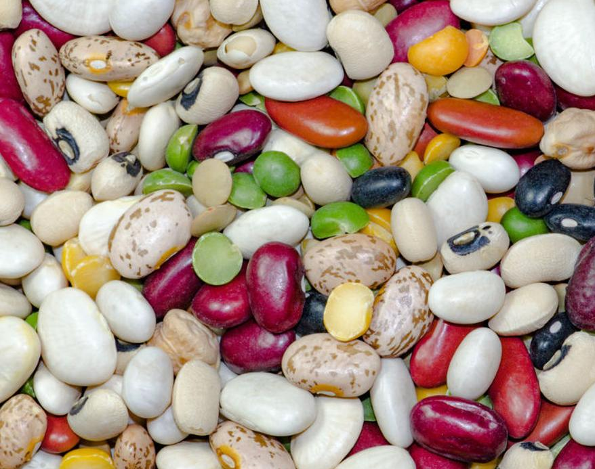
Classification Model for Dry-Beans
By Yordanos Woldebirhan
July 2021

Slide 2
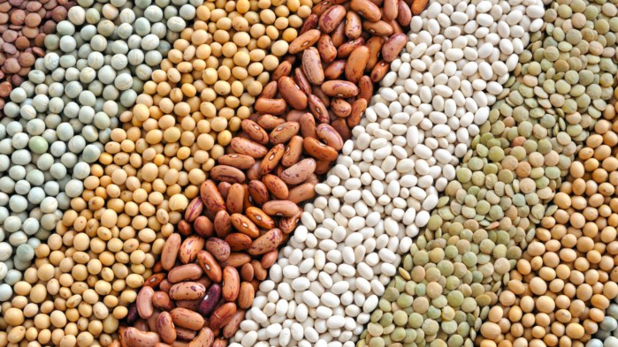
Content
Business use case
Dataset
Classes and Features
Model and results
Future work

Slide 3
Business use case
1. Demand
Dry beans are among the most popular crops worldwide
USA is the 4th producer
2. Quality
Uniform seed variety is important factor for both production and marketing
USDA grades beans according to mix ratio and other additional factors…
Example
3. Classification Importance
Increase market value
Increased cultivation productivity
To assist an automated bean processing line ..

Slide 4
Dataset
Obtained from UCI ML Repo
13, 611 datapoints
16 features
7 Classes
Classes are divided by form, shape, type and structure by Turkish Standard Institute ..

Slide 5
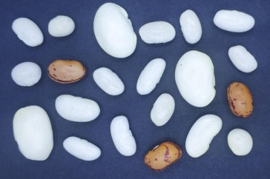
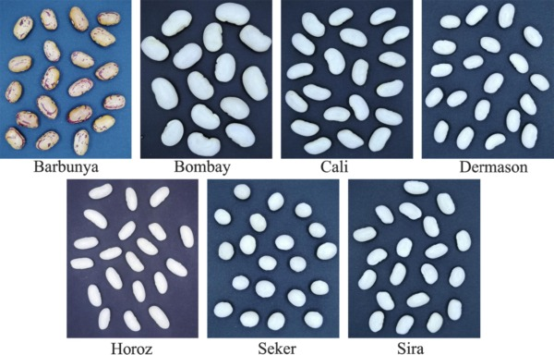
Classes and Features

Slide 6
Classes and Features
Area
Perimeter
Major axis length
Minor axis length
Aspect ratio
Eccentricity
ShapeFactor1 (SF1)
ShapeFactor2 (SF2)
.
.
.

Slide 7
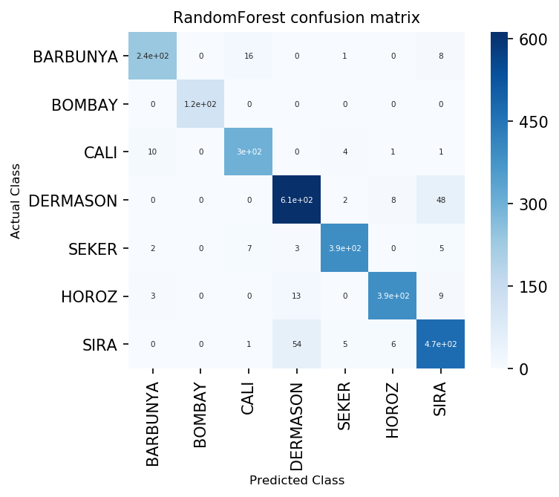
Models and results
KNN, Random Forest and Naïve Bayes models ….
Best model : Random Forest
Class | Precision
DERMASON | 0.90
SIRA | 0.88
SEKER | 0.96
HOROZ | 0.97
CALI | 0.92
BARBUNYA | 0.93
BOMBAY | 1.0

Slide 8
Conclusion
USDA Standards for beans may contain not more than 15.0 percent of beans of other classes that blend
Our classification can classify beans within acceptable standards I.e. Grade 2 and 3

Slide 9
Future work
Check for performance of model to get beans that contain not more than 2.0 percent of beans of contrasting classes , see if classify grade 1
Add features such as Moisture contain , Total defect, Total damage

Slide 10

Appendix

Slide 11
Meaning and calculations of the Features
1.) Area (A): The area of a bean zone and the number of pixels within its boundaries.
2.) Perimeter (P): Bean circumference is defined as the length of its border.
3.) Major axis length (L):Distance between the ends of the longest line that can be drawn from a bean.
4.) Minor axis length (l): The longest line that can be drawn from the bean while standing perpendicular to the main axis.
5.) Aspect ratio (K): Defines the relationship between L and l.
6.) Eccentricity (Ec): Eccentricity of the ellipse having the same moments as the region.
7.) Convex area (C): Number of pixels in the smallest convex polygon that can contain the area of a bean seed.
8.) Equivalent diameter (Ed): The diameter of a circle having the same area as a bean seed area.
9.) Extent (Ex): The ratio of the pixels in the bounding box to the bean area.
10.)Solidity (S): Also known as convexity. The ratio of the pixels in the convex shell to those found in beans.
11.)Roundness (R): Calculated with the following formula: (4piA)/(P^2)
12.)Compactness (CO): Measures the roundness of an object: Ed/L
13.)ShapeFactor1 (SF1)
14.)ShapeFactor2 (SF2)
15.)ShapeFactor3 (SF3)
16.)ShapeFactor4 (SF4)

Slide 12
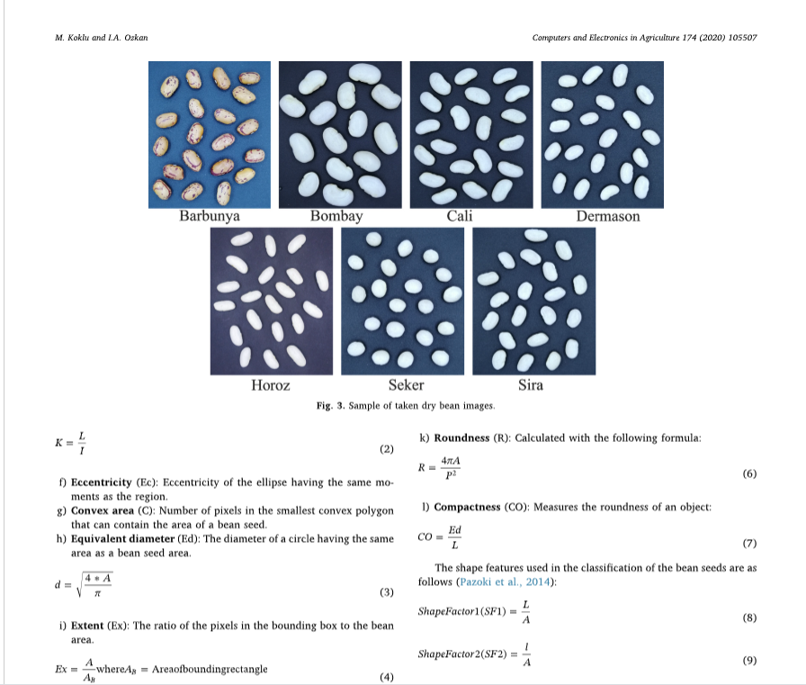

Slide 13
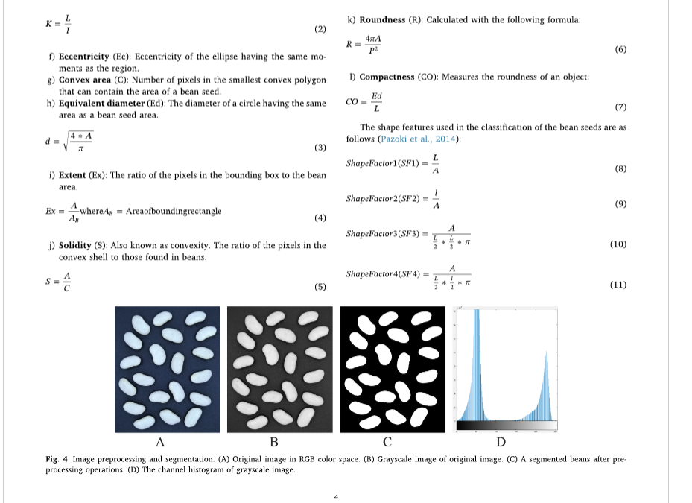

Slide 14
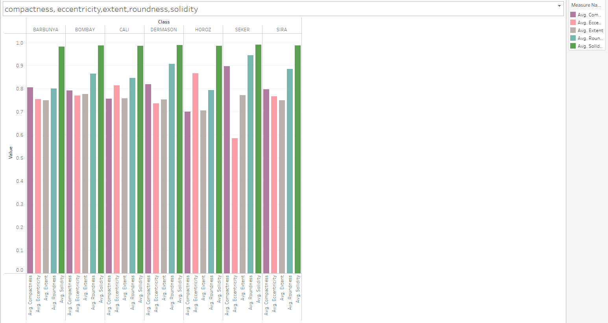

Slide 15
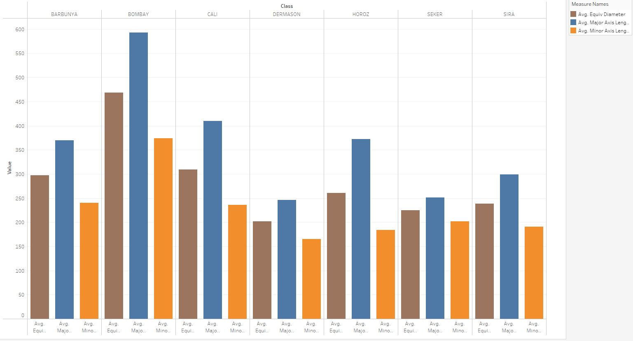

Slide 16
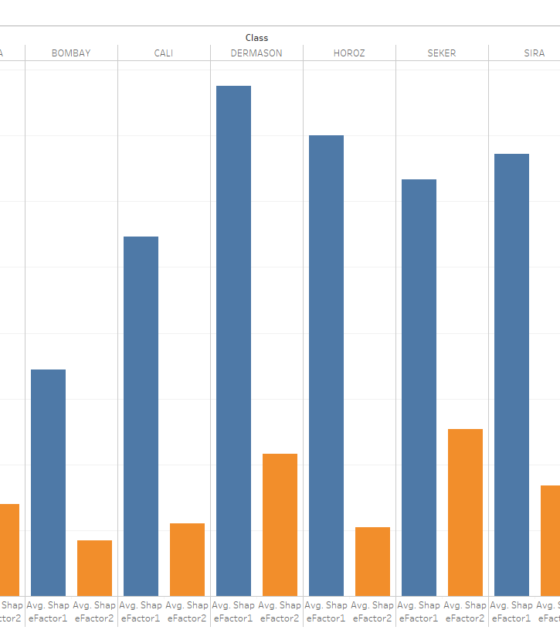
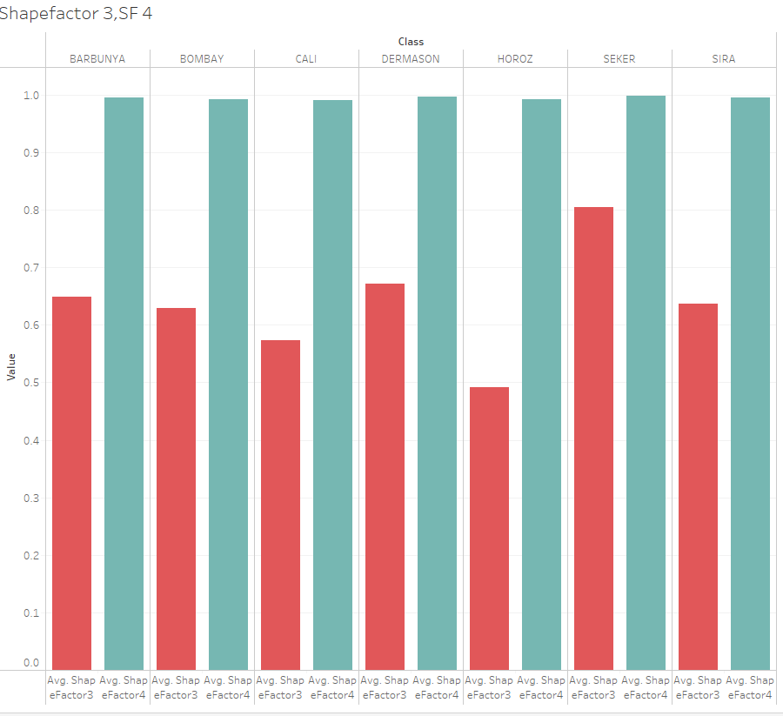

Slide 17
